Slide 1
Estimation
420-E31 Systems III
References:
Dennis: Chapter 2
http://www.softwaremetrics.com/Articles/estimating.htm
http://www.qsm.com/resources/function-point-languages-table
http://www.ibm.com/developerworks/rational/library/edge/09/mar09/collaris_dekker/
http://www.mountaingoatsoftware.com/articles/estimating-with-use-case-points

Slide 2
Estimation
Process of assigning projected values for time and effort
Very difficult to do
Most software estimations are off by 25-100%
Many tools that can be used
Usually start with rough estimates and move to more precise values
Rely on historical information
Industry standard figures are available

Slide 3
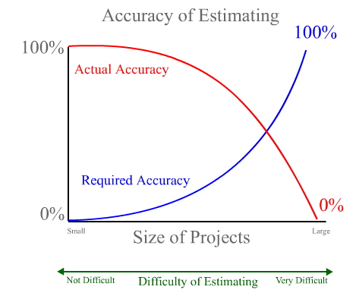
Accuracy of Estimating
Source: http://www.softwaremetrics.com/Articles/estimating.htm

Slide 4
4 Steps in Project Estimation
Basic process
Estimate the size of the product
function points & use case points
Estimate the effort
person-months
Estimate the schedule
calendar months
Estimate the cost
Dollar value

Slide 5
Step 1 - Estimate Size
Two main techniques:
By analogy – comparison to similar project done in the past. Can involve estimating lines of code
By analysis – counting product features and converting count to an estimate of size. Approaches are:
Function Points
Use Case Points

Slide 6
Step 2 - Estimate Effort
Usually measured in person-months
Two main techniques:
Organization’s historical data
Convert size estimate into effort estimate using an industry model
Effort can also be estimated directly based on description of the projects Implicitly assumes team productivity.

Slide 7
Step 2 - Estimate Effort (cont)
COCOMO model
COnstruction COst MOdel
Converts a lines-of-code estimate into a person-month estimate
For moderate-size projects multiply thousands of lines of code by 1.4 to get the number of people to assign to the project

Slide 8
Step 3 - Estimate Schedule
Determine schedule based on effort estimation.
Historical data can be used to predict how work can be broken down.
Can also use schedule estimation rule of thumb:
Schedule Time (months) = 3.0 x person-months ^{1/3}
Can use other factors, such as 2.0, 2.5 or 4.0, instead of the 3.0.

Slide 9
Step 4 - Estimate Cost
Many factors to consider: labour, hardware and software, telecommunications, travel, etc.
Depends on how organization allocates cost.
Simplest labour cost is project’s effort estimate in hours multiplied by general labour rate ($ per hour).
Historical data or industry data models can help

Slide 10
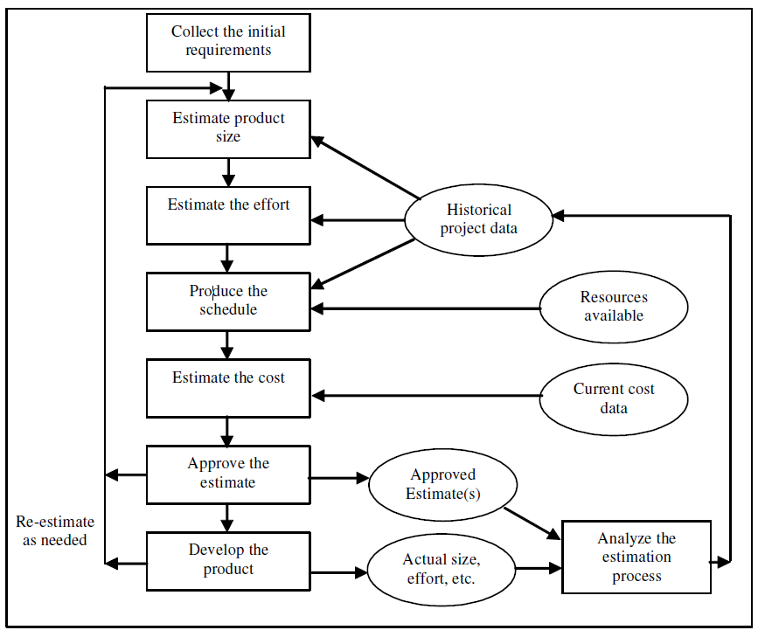
Basic Estimation Process
Source: www.spc.ca

Slide 11
Function Point Analysis
Function Point
A measure of program size that is based on the system’s number and complexity of:
inputs,
outputs,
queries,
files, and
program interfaces

Slide 12
Calculate Function Points
List major elements of system
Determine total number of each element
Specify complexity index of each component (low, medium, high)
Total index multiplied by number of components
Total Unadjusted Function Points (TUFP)
Notes:
Show Spreadsheet and add the following data
3, 2, 1
4, 10, 5
7, 0, 3
0, 15, 0
1, 0, 2

Slide 13
Function Point Estimation
Complexity
Description Low Medium High Total
Inputs __x 3 __x 4 __x 6 ____
Outputs __x 4 __x 5 __x 7 ____
Queries __x 3 __x 4 __x 6 ____
Files __x 7 __x 10 __x 15 ____
Program __x 5 __x 7 __x 10 ____
Interfaces
TOTAL UNADJUSTED FUNCTION POINTS ____

Slide 14
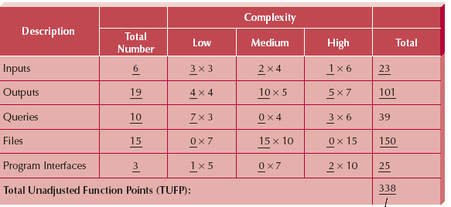
TUFP Example

Slide 15
Adjusted Processing Complexity
Total complexity is greater than sum of the parts
Familiarity of team, technology of implementation, etc. affect complexity
Add system factors to determine processing complexity
Multiply to get Total Adjusted Function Points
Notes:
Back to spreadsheet
DC = 3
Distributed functions = 2
Online data entry = 2
Can use static numbers 0.65 for easy; 1.0 for normal 1.35 for complex

Slide 16
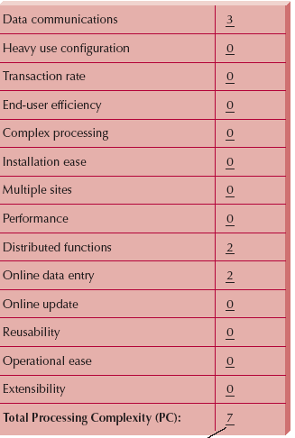
Adjusted Processing Complexity -- Step 2

Slide 17
Function Point Estimation
Processing Complexity (PC): __7______
(From Step 2)
Adjusted Processing
Complexity (PCA) = 0.65 + (0.01 * __7_ )
Total Adjusted
Function Points: _0.72 * _338_ = 243
(TUFP -- From Step 1)

Slide 18
Final Step
Multiply function points
Approximate lines of code per function point in the chosen language
If you chose C#, then 243 function points times 59 lines of code = 14,337 total lines of code

Slide 19
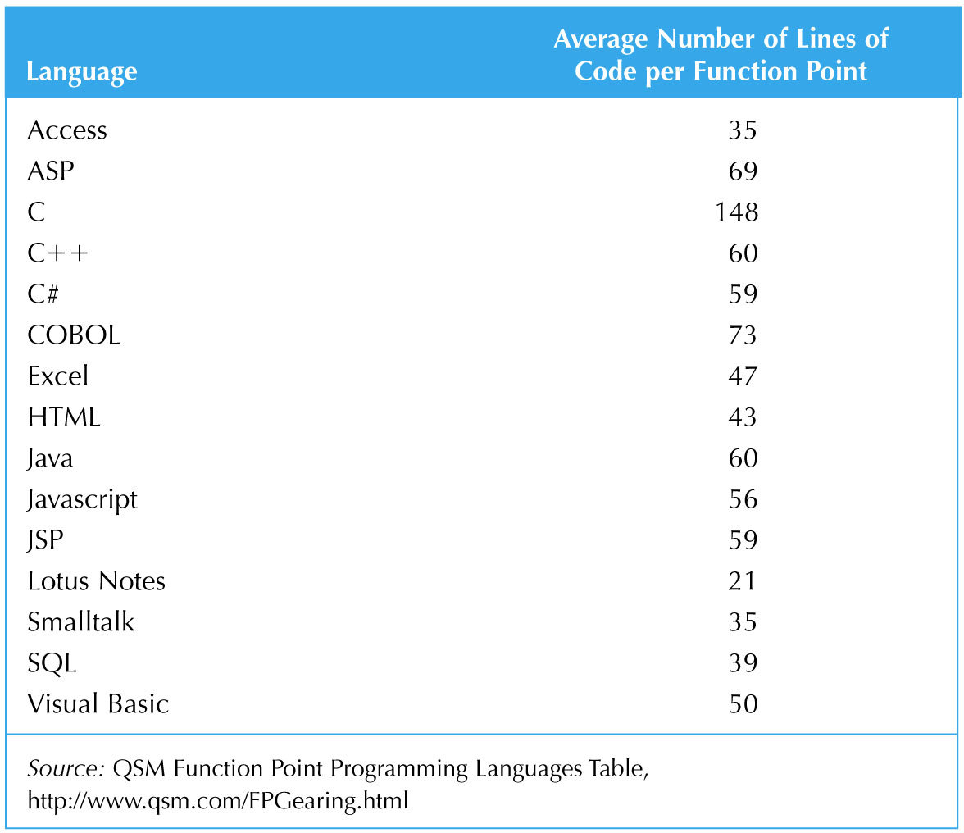
Function Points to Lines of Code
Notes:
http://www.qsm.com/FPGearing.html
Much longer list for many more languages

Slide 20
Use Case Estimation
LOC is unreliable method of estimation
Another technique uses Use Case Points
Developed at a company called Objectory AB that has since been bought by Rational which is now owned by IBM
Same idea as function points
Notes:
Unreliable because need to factor in quality of developers
Also, what about all the code that is automatically generated for you from IDE?
Also, what about systems that use multiple languages?
Not developed with OO in mind

Slide 21
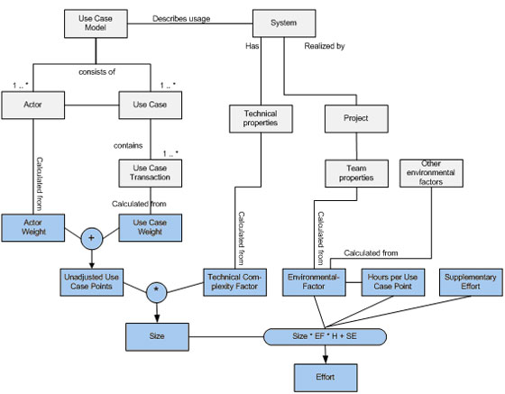
Use Case Points Estimation

Slide 22
Use Case Point Technique
Create essential use cases and actors
Create use case diagram
Classify actors as simple, average or complex
Classify use cases as simple, average or complex
Add technical complexity factors and environmental factors

Slide 23
Classify Actors
Simple
Another system that communicates with a well defined API
Average
Another system that interact using standard communication protocols (TCP/IP, SQL, FTP, HTTP)
Complex
A person using a GUI
Notes:
Go to example:
4 users
1 external system

Slide 24
Classify Use Cases
Simple
1-3 unique transactions
Average
4-7 unique transactions
Complex
>7 unique transactions
Transaction
“Round trip” from the user to the system back to the user
Notes:
9 use cases
3 simple
5 average
1 complex

Slide 25
Technical & Environmental Factors
Assign value 0 – 5 for each factor
0 – Not relevant
5 – Essential
Multiply by weighting factor to get a result. Sum to get a total.
Notes:
Example: 0,5,3,1,1,2,4,0,2,0
Efactor: 4,4,4,5,5,5,0,3

Slide 26
Technical Factors
Factor Number | Description | Weight
T1 | Distributed system | 2
T2 | Response time or throughput performance objectives | 1
T3 | End-user online efficiency | 1
T4 | Complex internal processing | 1
T5 | Reusability of code | 1
T6 | Easy to install | 0.5
T7 | Ease of use | 0.5
T8 | Portability | 2
T9 | Ease of change | 1
T10 | Concurrency | 1
T11 | Special security objectives included | 1
T12 | Direct access for third parties | 1
T13 | Special User training required | 1

Slide 27
Environmental Factors
Factor Number | Description | Weight
E1 | Familiarity with system development process being used | 1.5
E2 | Application experience | 0.5
E3 | Object-oriented experience | 1
E4 | Lead analyst capability | 0.5
E5 | Motivation | 1
E6 | Requirements stability | 2
E7 | Part time staff | -1
E8 | Difficulty of programming language | -1

Slide 28
Calculate Person Hours Multiplier
Determined by environmental factors
If requirements are stable and you have a good team, then it stays low
If don’t know technical environment, don’t have experience, etc., then it is higher
If there are a lot of these things together, you may be in trouble
Basically check out factors to success and multiply based on those

Slide 29
Calculation of PHM
if
sum of (# of Efactors E1 - E6 assigned value < 3) and (# of Efactors E7-E8 assigned values > 3) <=2 Then PHM = 20
Else If
sum of (# of Efactors E1 - E6 assigned value < 3) and (# of Efactors E7-E8 assigned values > 3) =3 or 4 Then PHM = 28
Else
Rethink Project as risk of Failure is too high

Slide 30
Use Case Points
Advantages
Based on O-O systems
Based on common technique
Process can be automated
Can be adapted to use organizational history
Disadvantages
Wait a little longer to make estimation
Rules for determining transactions are imprecise

Slide 31
PERT Analysis
Program Evaluation and Review Technique (PERT)
Part of Critical Path Analysis
Estimate minimum amount of time to perform task
optimistic duration (OD)
Estimate maximum amount of time to perform task
pessimistic duration (PD)
Estimate expected duration needed to perform task
expected duration (ED)

Slide 32
PERT Analysis
Calculate the most likely duration as follows:
Notes:
Examples
2, 10, 6
4, 12, 5
3, 8, 4

